Slide 1


Slide 2

A data flow diagram (DFD) is a graphical representation of the movement of data between external entities, processes and data stores within a system.
Simply put, DFD’s show how data moves through an information system.

Slide 3

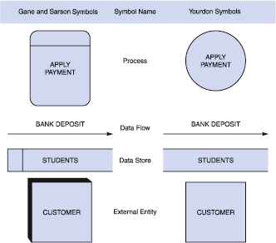

Slide 4

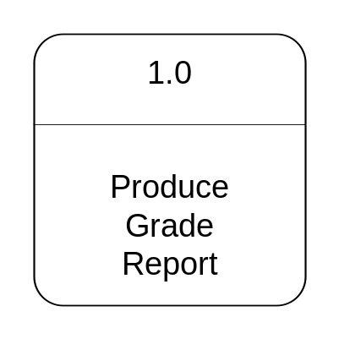
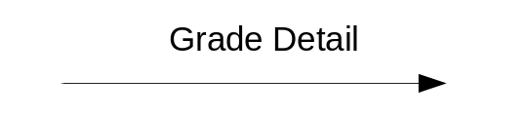

  The work or actions performed on data so that they are transformed, stored, or distributed.
  Process labels should be verb phrases!

Slide 5

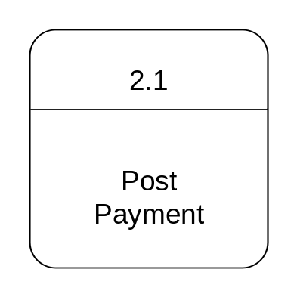

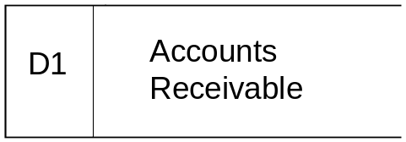

  A path for data to move from one part of the system to another.
  Data in motion!
    Arrows depict the movement of data.
  NO VERBS

Slide 6

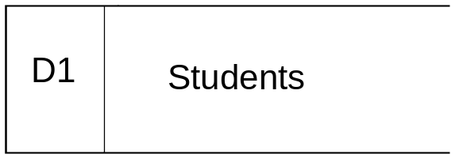
  Used in a DFD to represent data that the system stores
  Data at rest!
  Labels should be noun phrases
    (NO VERBS)

Slide 7

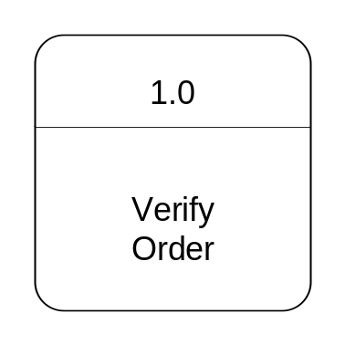
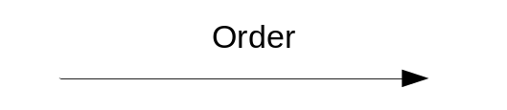
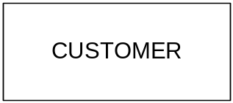

  The origin or destination of data!
    This represents things outside of the system.
  Source – Entity that supplies data to the system.
  Sink – Entity that receives data from the system.
  The labels should be noun phrases!

Slide 8

  Simple graphical techniques which are easy to understand
  Helps define the boundaries of the system
  Useful for communicating current system knowledge to users
  Explains the logic behind the data flow within the system
  Used as the part of system documentation file

Slide 9


Slide 10

ER model/diagram is used to show the Conceptual schema of an organisation.
Independent of specific data model or DBMS
The model/diagram is later transformed into a Logical model (e.g. relational) on which the physical database is built
The most widely used form of Semantic modelling: attempt to capitalise on knowledge of meaning of data to inform the model

Slide 11

  The basics of Entity-Relationship modelling
  Entities
  Relationships
  Attributes

Slide 12

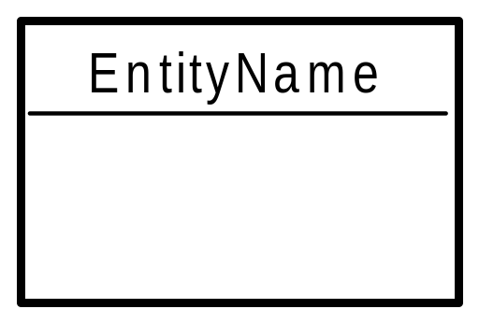
Entity - distinguishable “thing” in the real world
  Strong (or regular) entity - entities have an independent existence (e.g. staff)
  Weak entity - existence dependent on some other entity (e.g. next of kin)
Entity type name
(singular, no spaces,
capital letter at start of each word)
space for attributes

Slide 13

Entity types have Attributes (or properties) which associate each entity with a value from a domain of values for that attribute
Attributes can be
  simple (atomic) e.g. Surname; date of birth
  composite e.g. address (street, town, postcode)
  multi-valued e.g. phone number
  complex nested multi-valued and composite
  base or derived e.g. D.O.B. ; age
  key
Relationship types can also have attributes! (see later)

Slide 14

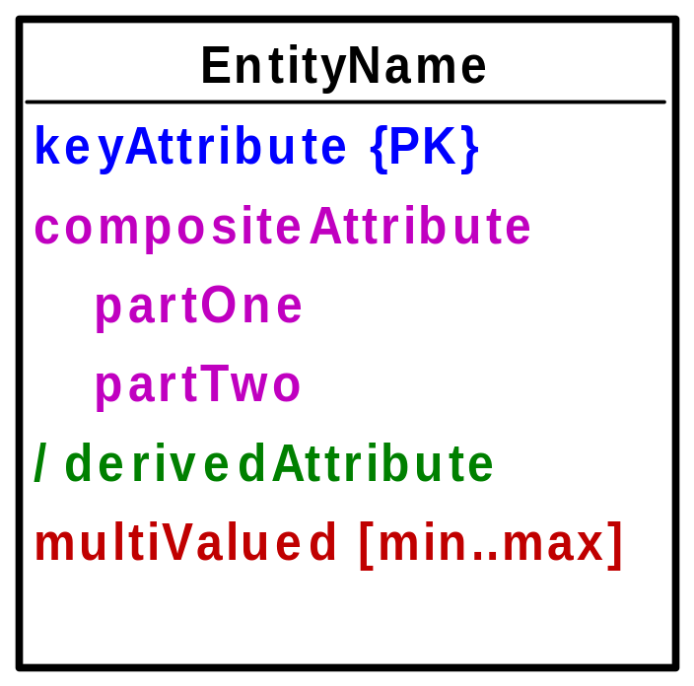
Primary Key
marked {PK}
Composite attribute
Derived Attribute
{PPK}
Partial Key
- part of composite PK
- or of a weak entity
Multi-Valued Attribute
(number of values in [ ] brackets)

Slide 15

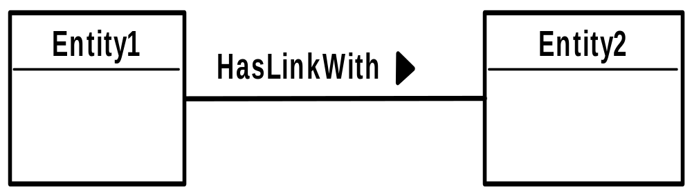
A relationship is
“.. An association among entities (the participants)..”
Relationships link entities with each other
Name: verb, capital start letter, arrow indicates direction in which verb makes sense

Slide 16

The degree of a relationship type
  binary (connects 2 entity types)
  unary/ recursive (connects 1 entity type with itself)
  complex (connects 3 or more entity types)
    Ternary (connects 3)
Relationship constraints - cardinality
  one to one (1:1)
  one to many (1:m)
  many to many (m:n)
Relationship constraints – participation
  full/mandatory
  or partial/optional
Degree
Multiplicity

Slide 17

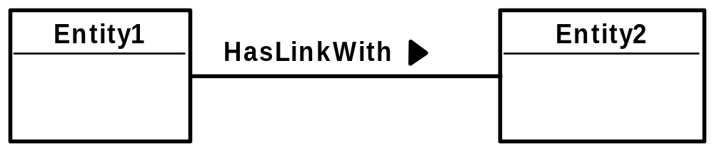
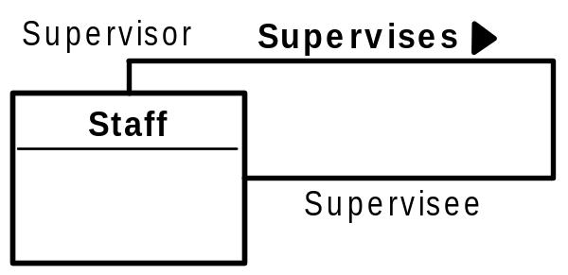
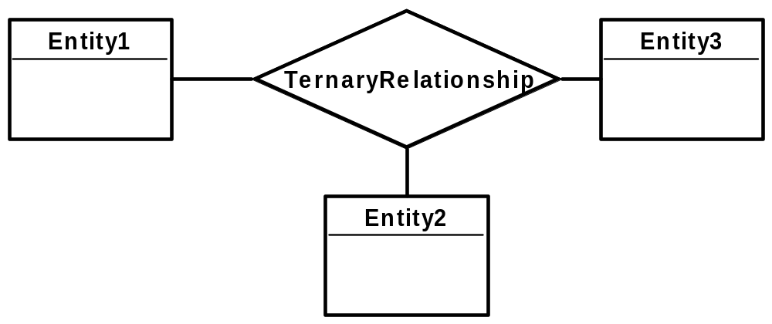
Binary relationship
Recursive (Unary) relationship - example
Complex relationship –
here ternary

Slide 18

label lines to show cardinality and participation
  0..1 “zero or one”
  0..* “zero or more”
  1..1 “one”
  1..4 “between 1 and 4”
  1..* “one or more”
optional
mandatory
1..1
0..*
Entity1 has a 1:m relationship with Entity2;
participation for Entity2 is mandatory, for Entity1 optional.

Slide 19

Manages
Manager
Department
1..1
0..3
responsibility [1..*]
dateAllocated
Each department is managed by ONE manager
Each manager manages UP TO 3 departments
(but need not manage any department)
Relationship attributes

Slide 20

A member of staff may supervise another staff member, but a staff member may be supervised by one or more staff members
⧫
supervises
0..*
Staff
0..1

Slide 21

“a client at a branch will be registered by one member of staff”
“a member of staff will register a client at one branch”
1..1
registers
1..1
Staff
Branch
0..*
Client
“a member of staff at a branch may register many clients”

Slide 22

DFDs and ERDs are both used to model systems, but they show two very different perspectives on the system
A DFD shows what the system does as well as the data that the system manipulates
An ERD shows only the data that the system manipulates.

Slide 23

Entities on an ERD often (but not always) correspond to data stores on a DFD
Attributes on an ERD usually correspond to data elements (listed in the data dictionary) that make up the data store and data flows on a DFD
Relationships on an ERD do not correspond to processes on a DFD.
Sources and sinks on a DFD usually do not show up as entities on an ERD

Slide 24
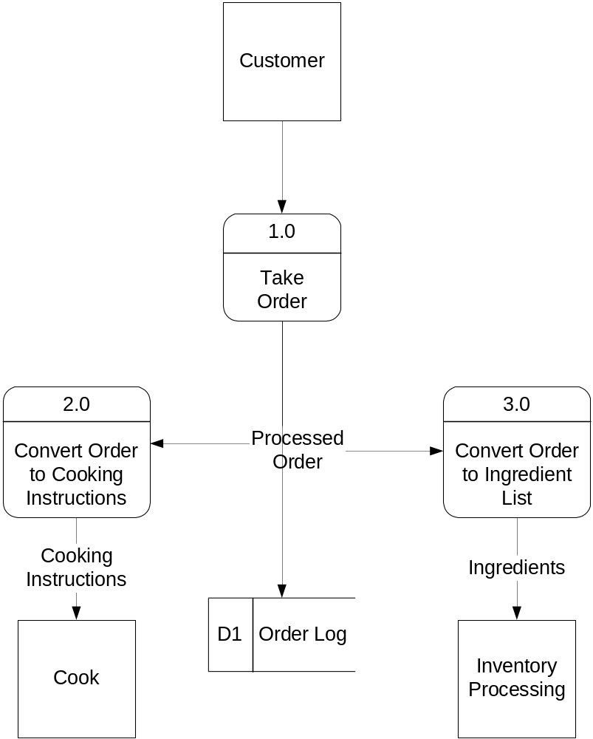
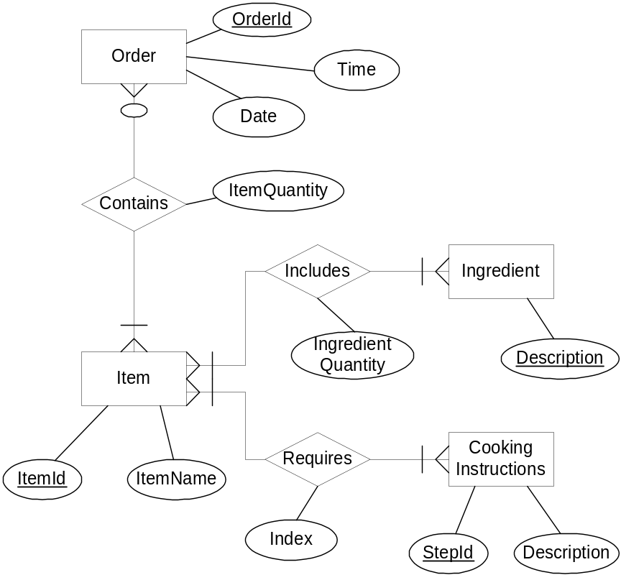
Example DFD and ERD
DFD
ERD

